Slide 1
Ministry Name: Ministry of Communications Problem Statement : Cost effective innovative solution for long distance (3 to 8 kms) Problem Code : PJ238 Category : Hardware Domain Bucket : Smart Communication Team Name : Team Hexa Team Leader Name : Sunidhi Pranjale College Code : 1-4266701337
Idea/Approach Details
Youtube link for basic idea of our solution : https://youtu.be/RMggwGhhWmA

Slide 2
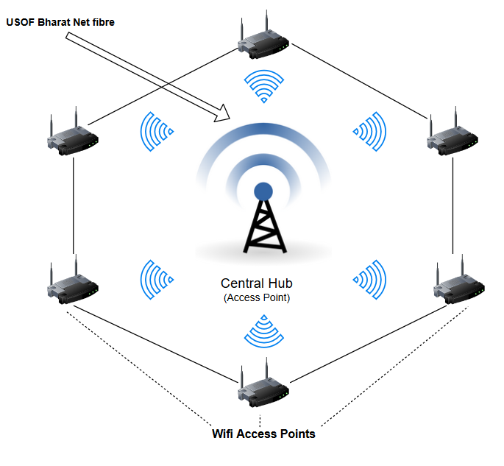
Single cell layout of Hexa-AP ( Access Point)
This is the flow layout for a single cell.
By making use of central hub as Wi-Fi Repeater or using the concept of Wi-Fi Direct, data or information will be shared to other secondary routers aligned in a hexagonal manner wirelessly.
And then this single cell layout will be converted to multi cell layout and in this way whole area will be covered in an efficient way with less time consumption and all sparsely located individual households will be able to connect to it which also help in bridging the Digital Divide to a greater extent.

Slide 3

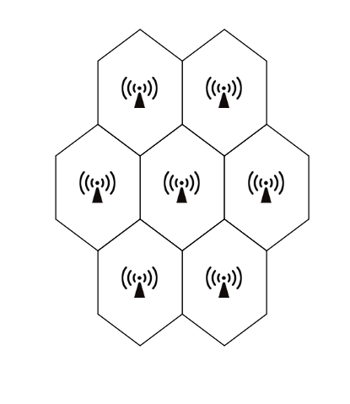
Multi cell layout of Hexa-AP( Access Point )
Explaination of Hexa-AP for a single cell :
Wireless LAN( 802.11 ) concept is used.
Bharat Net LAN will be connected to a central hub router .
By using the concept of Wi-Fi Direct, this hub will give wireless access to other 6 secondary routers which are arranged in a hexagonal cell order.
These secondary routers and central router act as Wi-Fi Access points for other wireless devices, such as mobile, laptops, etc. These hexagons will be closely joined.
Hexagonal structure will be used because:-
Its distance from center to any other point is the same, which provides equal signal in that cell.
Hexagon structure covers the more surface area.
These can be arranged in such a way that no black spots( blind spots ) are created.
In this way Wi-Fi access will be increased and will be given to all
One time investment will be there for setup of these Wi-Fi routers and networks.
In this way networks and routers setup will be done to increase Wi-Fi range.
Making Use Of Old Router As Wi-Fi Repeater Without Cable or Wi-Fi Extender .

Slide 4
Technology Stack Hardware Requirements: 1) Wi-Fi Routers 2) LAN cables 3) Laptop 4) Bharat Net LAN or any other internet access through LAN
Use Cases
1). It can be used in areas where LAN cable distribution to every node( individual household ) is not feasible.
2). It is a cost effective solution for long distance wireless (LAN) Broadband Connectivity to sparsely located individual households in rural areas.
Dependencies / Show stopper
1). All routers administrator network settings should be accessible, so as to direct the central hub internet wirelessly to other nodes/ Wi-Fi routers.
2). Our show stopper is the concept of “ Wi-Fi Direct “ which enables Wi-Fi devices to connect wirelessly or directly without cable, making it simple and convenient to do things like print, share, sync etc; wirelessly.
Youtube link for basic idea of our solution : https://youtu.be/RMggwGhhWmA

